Slide 1


EDA for Real Estate Pricing
Unveiling the Dynamics of House Valuation in a Dynamic Market
This presentation will cover the EDA process for Real Estate Pricing using Python libraries, including Pandas, NumPy, Matplotlib, and Seaborn.
In this project, I used Pandas for loading, cleaning, and organizing data.
I handled missing values by dropping columns with extensive gaps, like Alley & MasVnrType, & filling gaps in critical columns, such as Electrical, with the mode. NumPy supported numerical computations, while Matplotlib & Seaborn helped visualize key patterns and correlations in the data.
Through univariate and multivariate analysis, I explored price distributions and identified significant factors like location, lot area, & overall quality that influence prices. Feature engineering steps, such as calculating Total Living Area & Price per Square Foot, enhanced the dataset, revealing deeper insights into real estate trends and laying the groundwork for predictive modelling.
by Debasis Baidya

Slide 2





Importing of the necessary Libraries & Modules
Numpy
It helped with mathematical operations, allowing me to compute statistics and handle missing values efficiently.
Pandas
To load & organize the datasets, making it easy to explore the data structure and perform operations like merging and filtering.
Matplotlib
Used it to create visualizations, such as bar charts and histograms, to better understand the data distributions and trends.
Seaborn
For generating more advanced visualizations, helping me check for skewness & visualize correlations between different variables.
Math Module
Used math.ceil to calculate the number of rows needed for subplots, ensuring all features fit in the boxplots by rounding up the division of total features by columns.

Slide 3

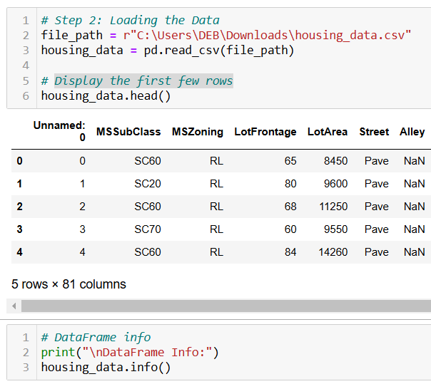
Loading Data & Checking Info
1
Loading Data
Reading the CSV file using pandas.
2
Displaying the Data
Displaying the first few rows using head() method.
3
Checking Data Information
Using info() to view Column Types, data counts, Data Types.

Slide 4
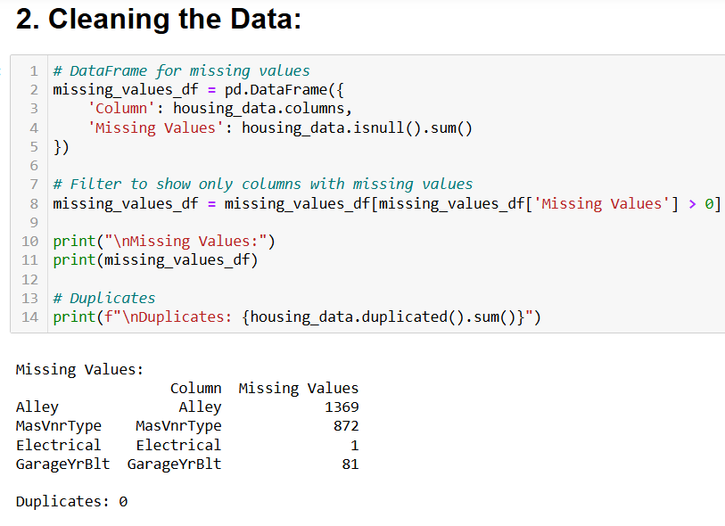
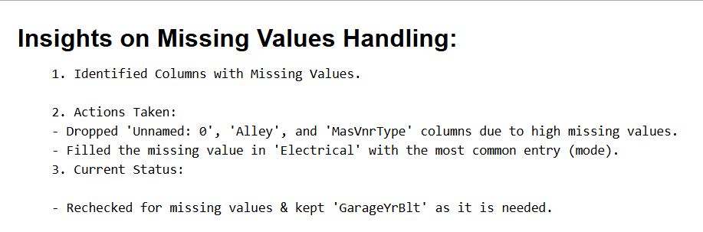
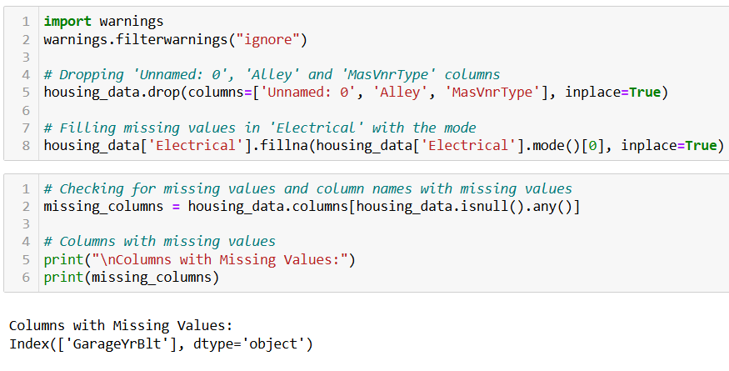
Data Cleaning & Preprocessing
1
Dropping Columns
2
Filling Missing Values
Removed unnecessary columns like 'Unnamed: 0', 'Alley’, & 'MasVnrType'.
Used mode to fill missing values in 'Electrical' column.
3
Checking Remaining Missing Values
Identify columns still containing null values.

Slide 5




Univariate Analysis
Distribution of Sale Price
01
Overall Quality
02
Distribution of Lot Area
03
Distribution of Year Built
04
Visualized the distribution of sale prices using a histogram with a kernel density estimate (KDE) curve.
Count plot showing distribution of overall quality ratings.
Visualized the distribution of lot areas using a histogram with a KDE curve.
Visualized the distribution of years built using a histogram with a KDE curve.

Slide 6
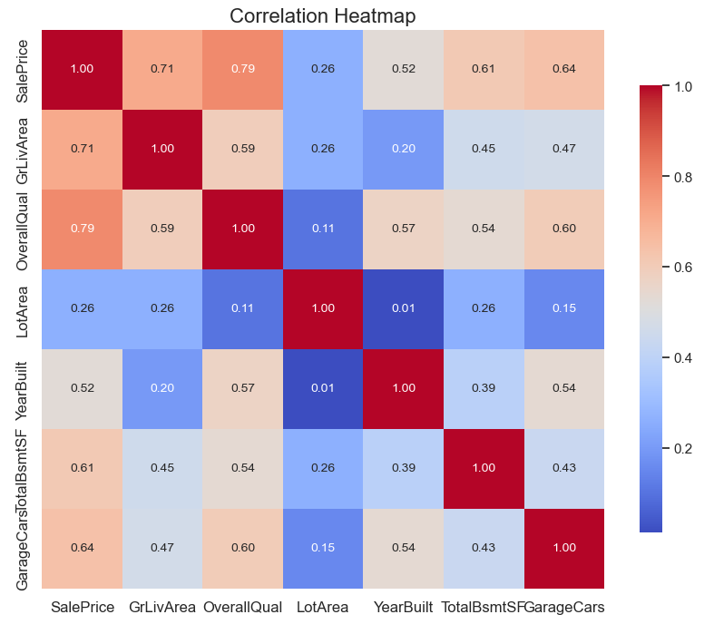
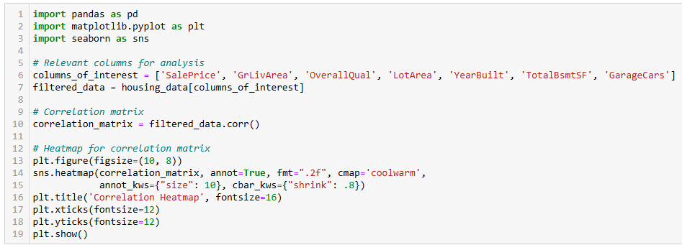
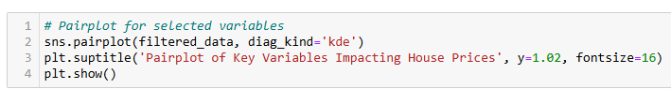
Multivariate Analysis

Slide 7
Feature Engineering
2
3
1
Total Living Area
Sum of first floor, second floor, and basement square footage.
Total Bathrooms
Combined count of full and half bathrooms, including basement bathrooms.
Property Age
Calculated as the difference between the current year (2024) and the year built.
4
5
6
High Quality Indicator
Binary indicator (0 or 1) based on whether the overall quality rating exceeds 7.
Price per Square Foot
Calculated by dividing the sale price by the living area square footage.
Year Built Age
Difference between the current year (2024) and the year built, indicating the age of the property.

Slide 8
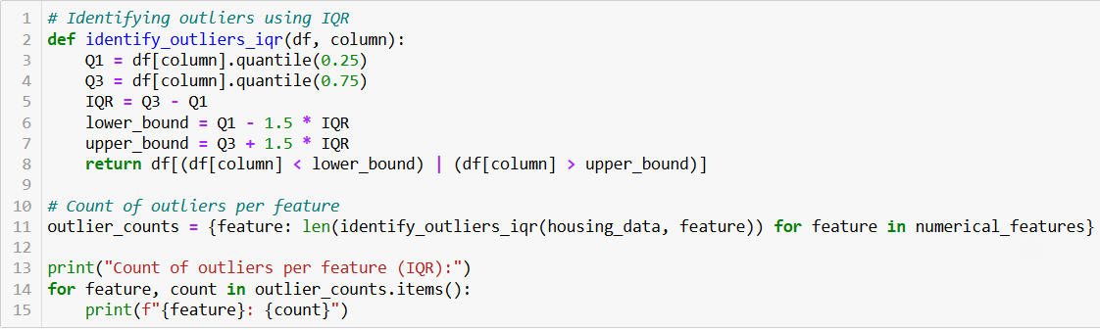
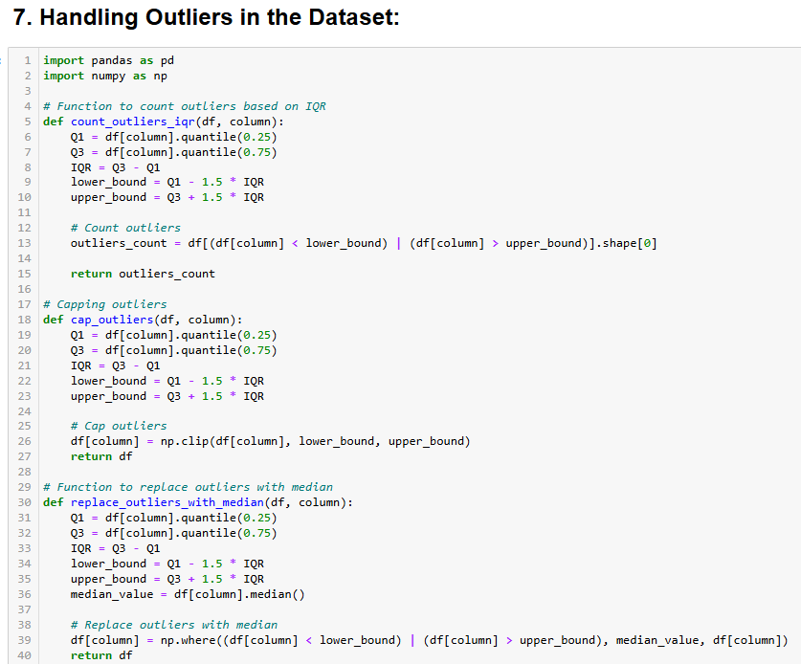
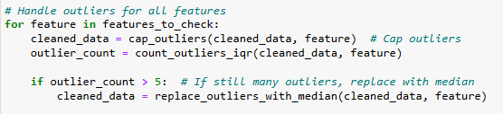
Outlier Detection and Handling
1
Identify Outliers
Use Interquartile Range (IQR) method to detect outliers.
2
Cap Outliers
Set upper and lower bounds based on IQR.
3
Replace Extreme Outliers
Use median for features with many remaining outliers.

Slide 9
Feature Engineering and Size Impact
01
02
03
04
Bedrooms vs. Price
Full Bathrooms vs. Price
Total Living Area vs. Price
Total Bathrooms vs. Price
Boxplot showing how the number of bedrooms affects sale price.
Scatter plot depicting the relationship between total living area and sale price.
Boxplot showing how total bathrooms influence sale price.
Boxplot illustrating the impact of the number of full bathrooms on sale price.
05
06
07
Property Age vs. Price
Price per Square Foot vs. Price
High Quality Indicator vs. Price
Scatter plot indicating how property age affects sale price.
Scatter plot demonstrating the correlation between price per square foot and sale price.
Boxplot illustrating the effect of overall quality on sale price.

Slide 10
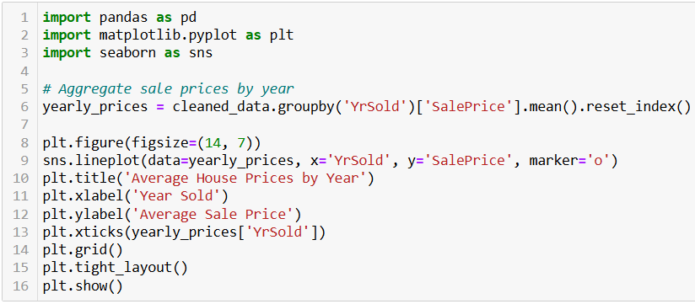


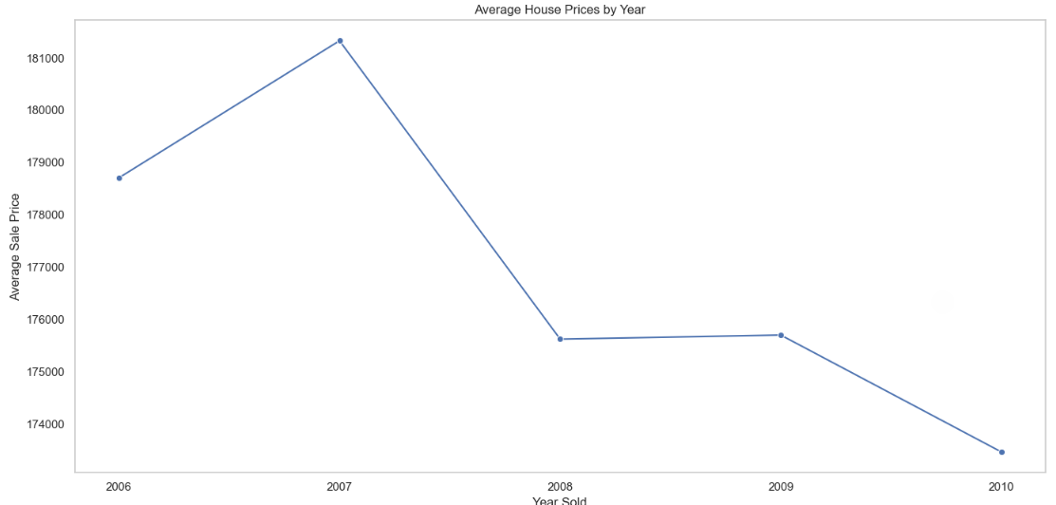

Time Trends in Housing Prices
Grouped by Year
Aggregated sale prices for each year sold.
Calculated Averages
Computed mean sale price per year.
Plot Trend
Created line plot showing price trends over time.

Slide 11





Impact of Amenities on Price
Pool Quality
Garage Type
Analyzed how pool quality affects home prices.
Examine price differences based on garage types.
Fireplace Quality
Basement Quality
Assessed impact of fireplace quality on home values.
Evaluated how basement quality influences prices.

Slide 12

Thank You!
Project Summary
Key Features
This project performs an EDA on real estate pricing data to identify factors influencing property values. Key steps include data cleaning, missing value handling, and feature engineering, focusing on variables like location, lot size, and quality to prepare the dataset for predictive modelling.
2
Data Cleaning: Removed unnecessary columns and handled missing values (e.g., mode and median imputation).
Feature Engineering: Added Total Living Area and Price per Square Foot for enhanced insights.
Visual Analysis: Used plots to reveal price distribution and feature correlations.
1
Future Enhancements
Q&A
3
Advanced Modelling: Implement regression models to predict prices.
Expanded Feature Engineering: Include more detailed neighbourhood metrics.
4
I am available to answer any questions you may have. Feel free to reach out to me for any questions or clarifications.

